Slide 1

Immune Receptor Profiling Nanocourse: Session 2- Community standards, Data analysis and interpretation
Organized by the VDJServer Team
June 1, 2018
UT Southwestern Medical Center

Slide 2
AGENDA
8:45am – 9:00am Setup, Registration, provide workshop handouts to participants
9:10am – 10:30am Introduction session
9:10am – 10:30am: Immune system overview (including immune sequencing technology and summary of vdjserver workflow for analysis); Setup IgBlast jobs with demo files
Show slides and video
10:30am-10:40am Break
10:40am – 11:45am Session 1- Data digest
Demo data and VDJServer hands-on demonstrations
Elaborate on the functionalities and benefits of VDJServer such as: no need to install anything, reproducibility, easy to use, data is stored on your account and is private, collaborative sharing of data, and long term archiving.
Breakout and setup RepCalc VDJServer “jobs” (provide one-on-one assistance and point participants to quickstart protocol @ handout pages)
11:45am – 1:00pm Lunch
1:00pm – 2:40pm Session 2- Community standards, Data analysis and interpretation
Look at example of pre-processing using FASTQ files
MiAIRR Standards overview and discussion
Analysis and interpretation of repertoire calculations output
2:40pm-2:55pm Break
3:00pm-3:45pm
Downstream application of VDJServer products in machine learning (example dataset using the demo dataset and discussion of some outcomes)
3:45pm-4:15pm
Summarize the workshop and encourage future interactions
Invitation to use some example datasets for further analysis (VDJServer team will assist in setup as time permits)

Slide 3
Session 2 objectives
Demonstration of pre-processing tasks using fastq files (using example data from a vdjserver project)
Review the MiAIRR Standards (discuss the steps involved and how to approach these steps for submission of data during publication)
Analyze and interpret data from repertoire calculations

Slide 4
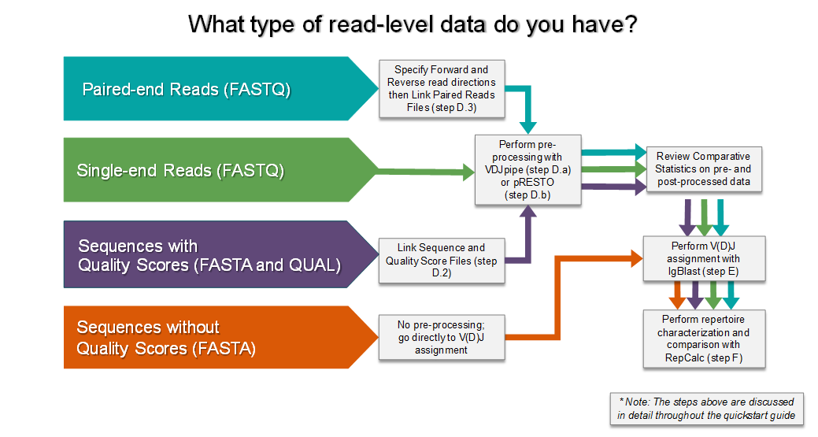
Pre-processing with Fastq files

Slide 5
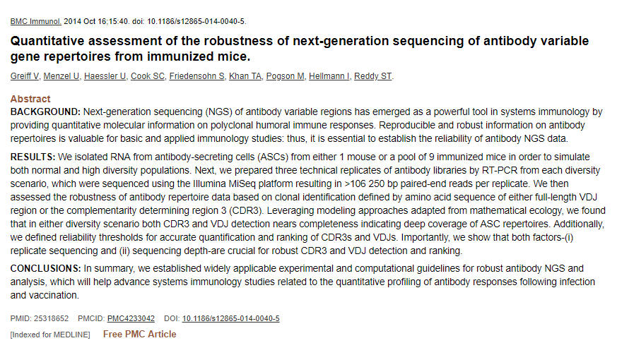
Pre-processing example using AIRR community data (reference manuscript)

Slide 6
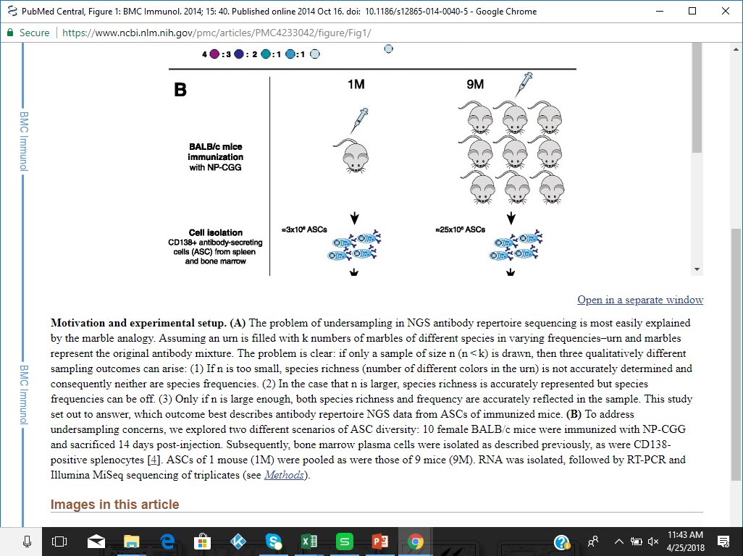
Experimental Setup (reference manuscript)

Slide 7
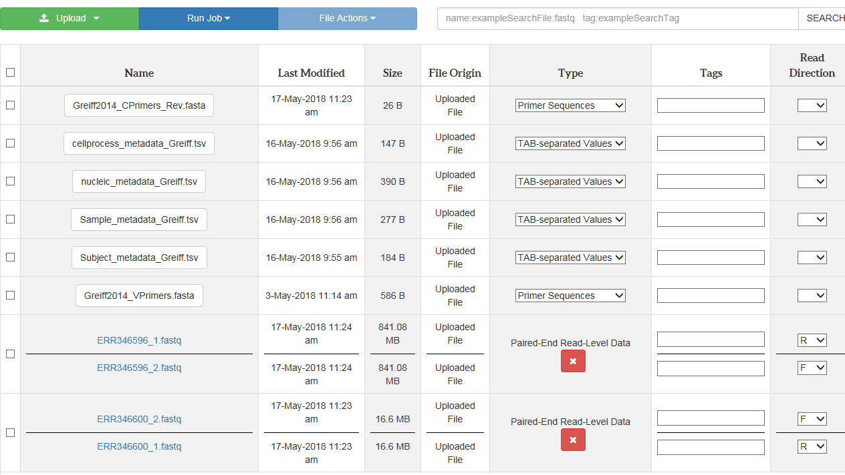
A look at the vdjpipe application (exploring pre-processing steps on VDJServer)

Slide 8
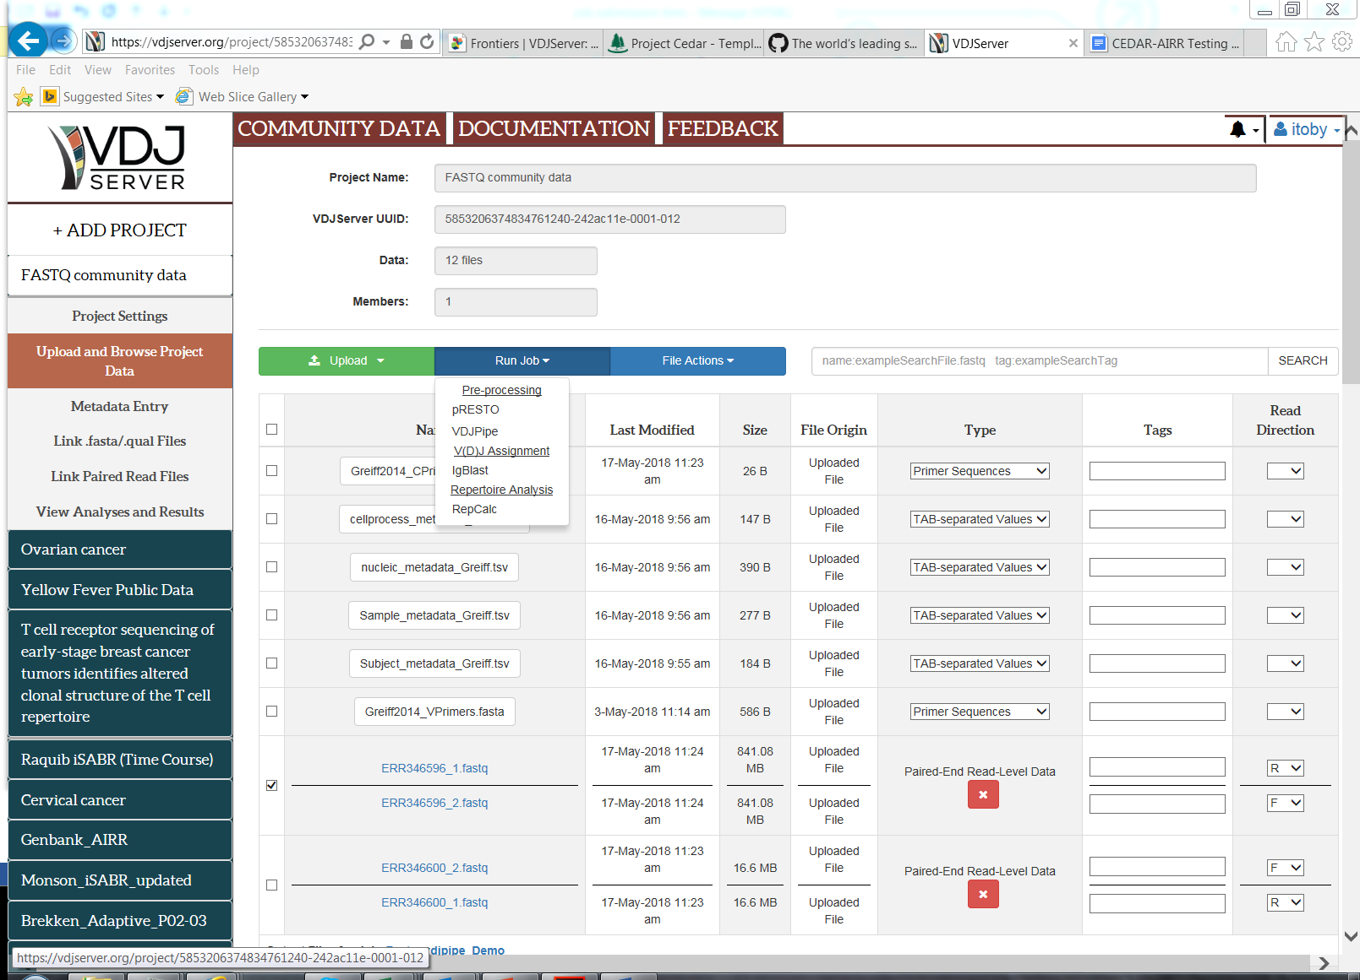

Slide 9
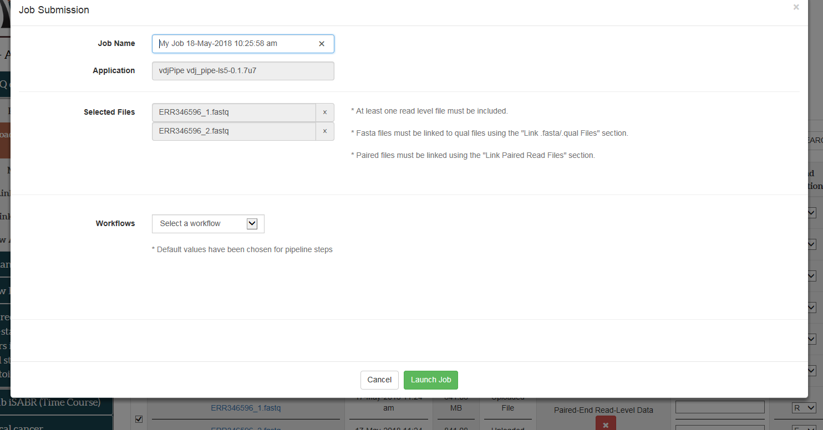

Slide 10
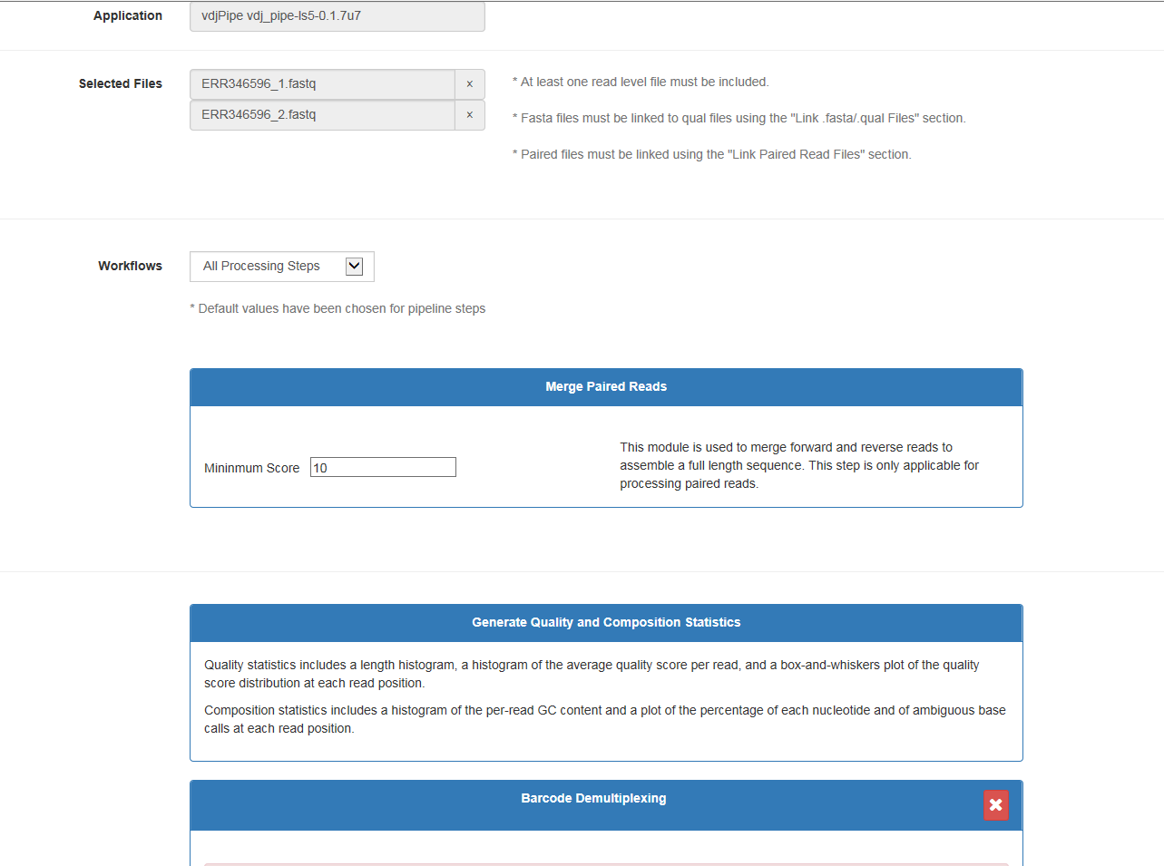

Slide 11
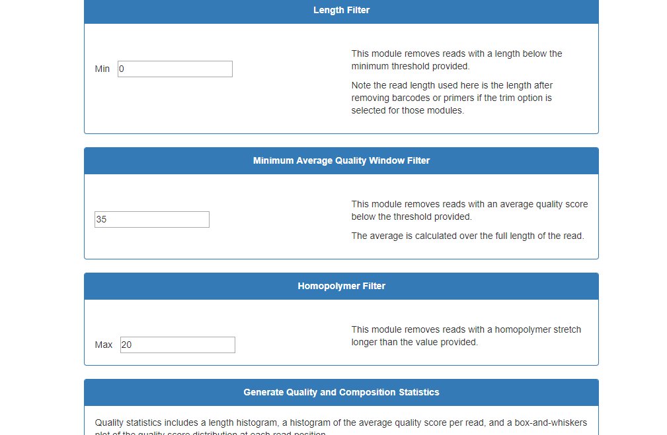

Slide 12
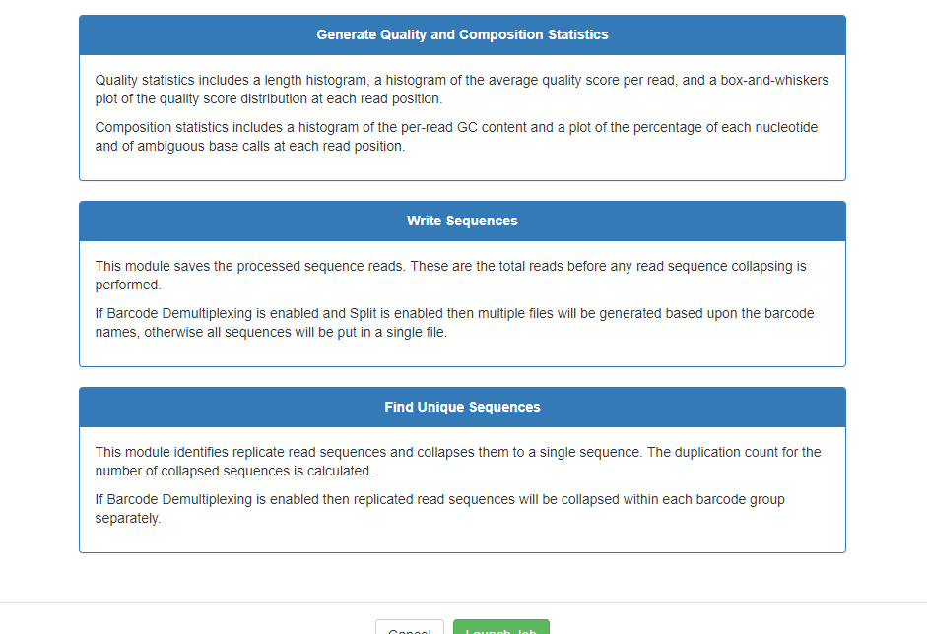

Slide 13
Pre-processing with Fastq files (review)

Slide 14
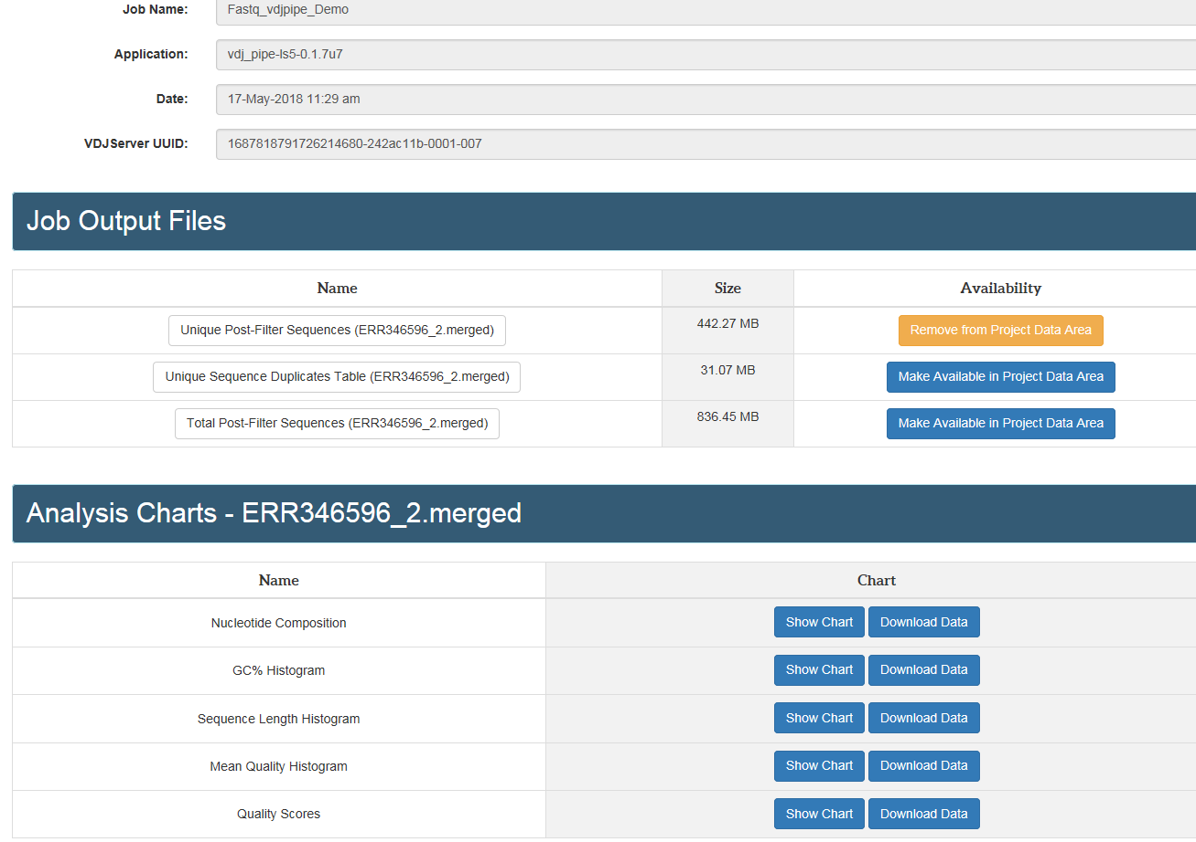
Output files from pre-processing steps

Slide 15
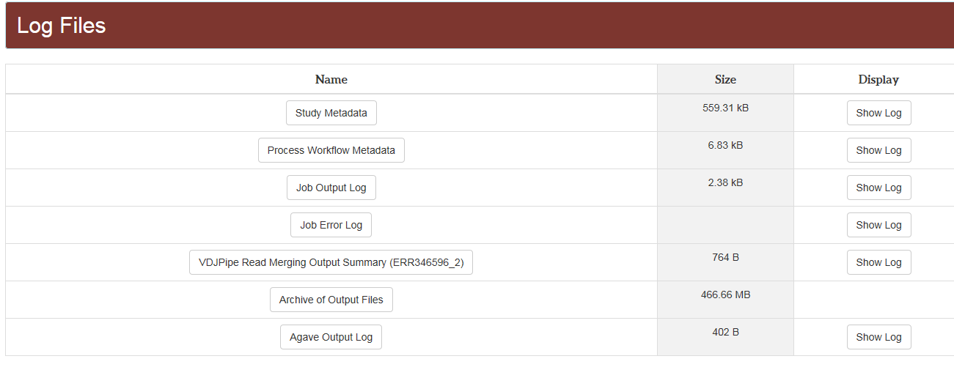
Output files from pre-processing steps

Slide 16
Pre-processing summary
Files uploaded to VDJServer
Selection of processing steps for vdjpipe application
Run files and generate processed fasta files
Proceed with vdj assignment using the IgBlast application and followed by repertoire calculations (using repcalc)

Slide 17
AIRR Community and MiAIRR Standards
Reference handouts

Slide 18
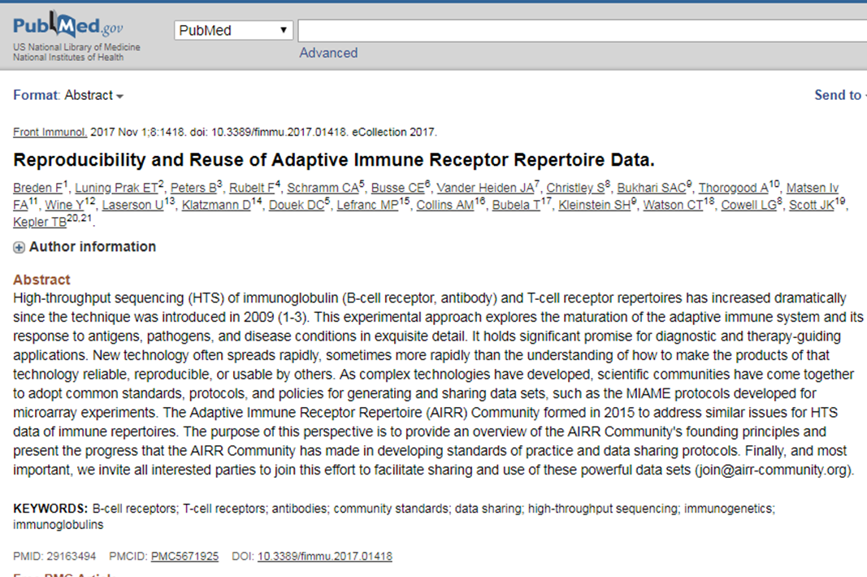

Slide 19
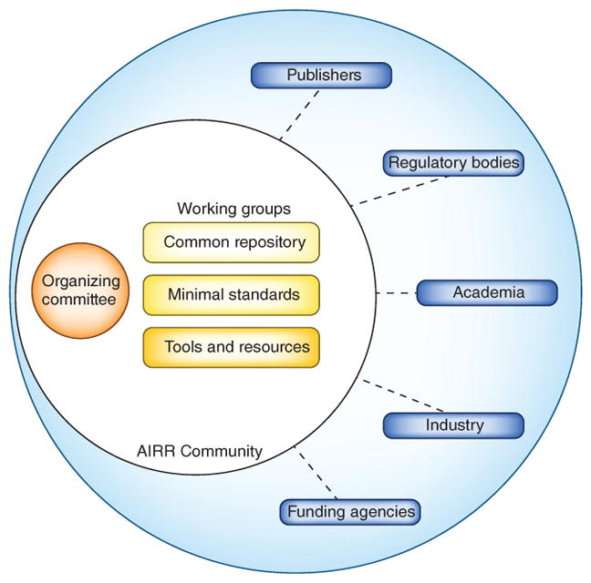
AIRR community interactions

Slide 20
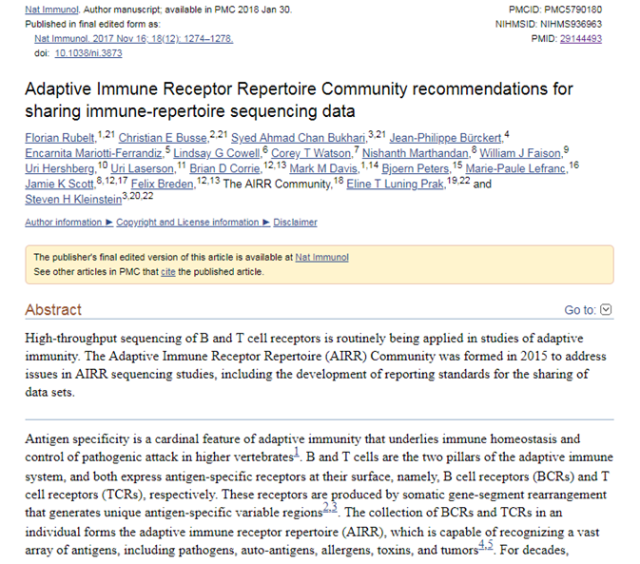

Slide 21
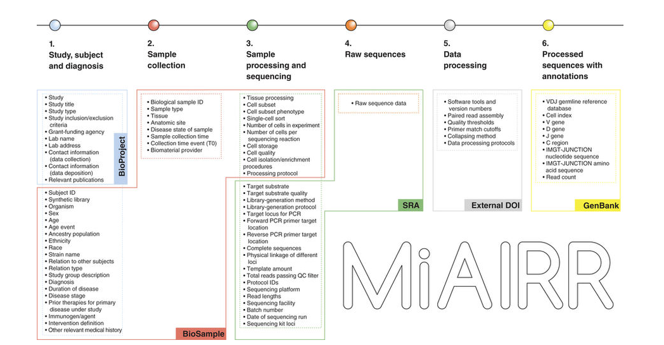

Slide 22
Summary
The Adaptive Immune Receptor Repertoire (AIRR) Community formed in 2015 to address reproducibility and reuse issues for HTS data of immune repertoires.
The community has made significant progress in developing standards of practice and data sharing protocols.
The key recommendations set forth comprise of six MiAIRR sets and associated data fields, along with their target submission repositories to promote data standardization across all the studies within the community.
VDJServer enables you to fulfill all of the MiAIRR submission requirements covered by the six sets and also provides you with a “one-stop” shop from start to finish.

Slide 23
Repertoire Calculations Overview

Slide 24
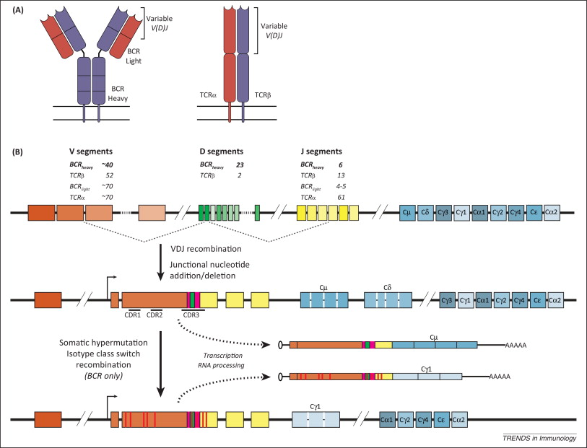
Schematic for VDJ recombination in B and T cells
PMID: 25306219

Slide 25
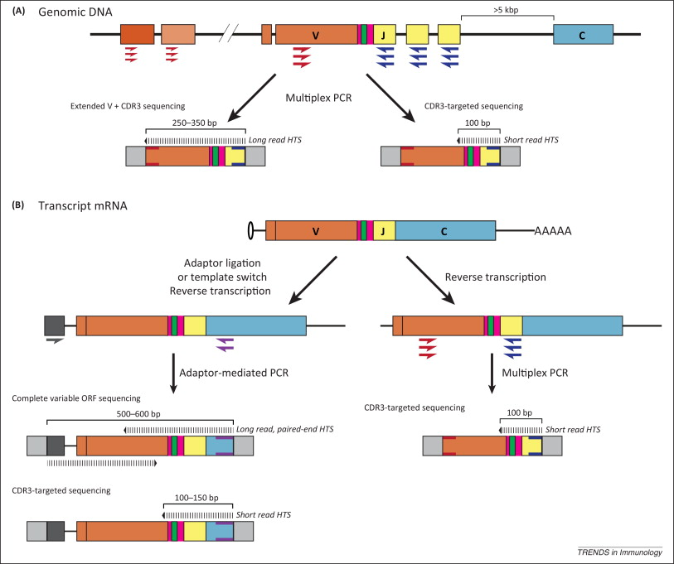
Schematic for VDJ genes derived from immune sequencing approaches
https://doi.org/10.1016/j.it.2014.09.004

Slide 26
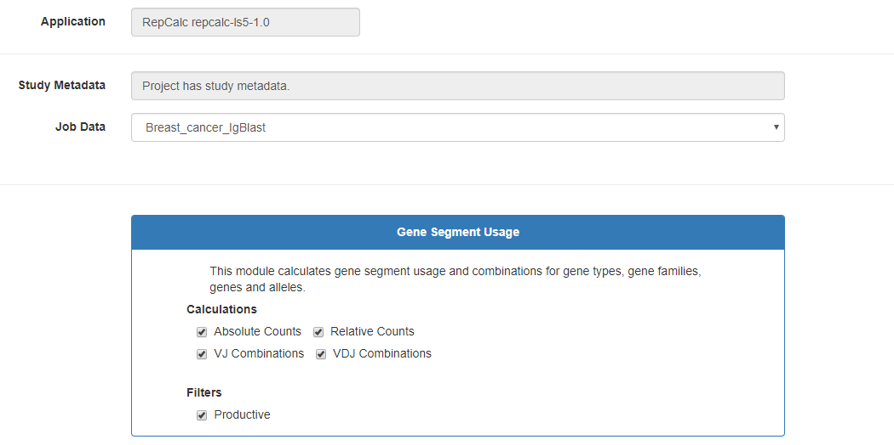
Exploring repertoire calculation options on VDJServer
This module provides summary counts of V, D and J genes from all filtered read level data
provided (extracted from the read-level fasta files).

Slide 27
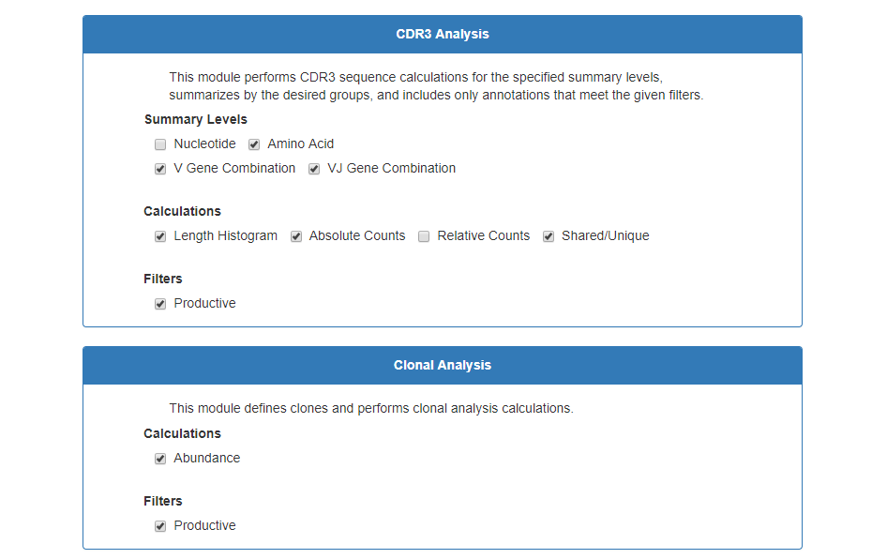
These modules provide summary counts (CDR3 analysis) and graphs (clonal analysis) showing abundance of CDR3 sequences (clones) from all filtered (productive) read level data extracted from the read-level fasta files.

Slide 28
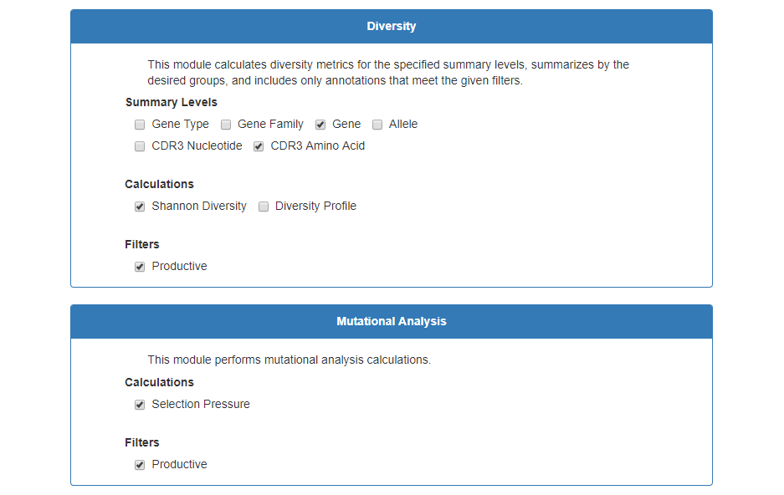
These modules provide calculations for diversity (using the diversity index metric) and mutational analysis using selection pressure (this applies to immunoglobulin (B-cell) receptors only due to somatic hypermutation in B cells (slide #24).

Slide 29
Review of RepCalc output results
Reference manuscripts for detailed information on module calculations for clonal abundance and diversity: https://www.ncbi.nlm.nih.gov/pubmed/?term=28179494+26589402+26069265+25675496+24618469+22641856+24298272%5Buid%5D
Overview of the log files provided by repcalc application (highlight-Archive of output files)
Discussion of CDR3 clones and clonal comparison approaches
Discussion of research questions and review of findings

Slide 30
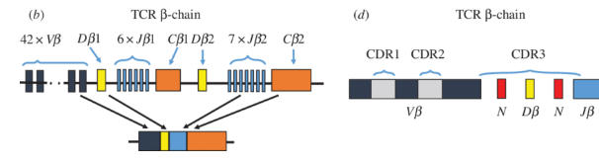
Typical data analysis questions (some examples)
What are gene segment usage (V/D/J) patterns across samples?
What are the cdr3 sequence (clonal) abundance patterns across samples?
What is the diversity observed across samples?
Which cdr3 sequences are shared across samples?
Data analysis questions can be targeted at:
subject
sample
sample group (using available metadata)

Slide 31
Clonal Abundance
Clonal abundance is the prevalence of a given CDR3 sequence (clone) within a given dataset.
This metric is based upon using the observed CDR3 clonal frequencies, where the size of each clone is determined by the number of sequence members
Reference:
https://cran.r-project.org/web/packages/alakazam/vignettes/Diversity-Vignette.pdf
The abundance count of each clone (dup count), is calculated and each clone is weighted by its corresponding abundance count.
Additionally, unweighted clone size is taken as a fraction of total sequences in the group and weighted fraction are normalized to within multiple group data partitions.

Slide 32
Diversity
A diversity index is a quantitative measure that reflects how many different types of sequences (CDR3) there are in the dataset, and simultaneously takes into account how evenly the sequences are distributed among those types.
An example of this is used in ecology, where the entities of interest are usually individual plants or animals, and the measure of abundance can be, for example, number of individuals, biomass or coverage;
This calculation approach on vdjserver utilizes previously published equations from Hill et al. and Chao et al. https://cran.r-project.org/web/packages/alakazam/vignettes/Diversity-Vignette.pdf

Slide 33
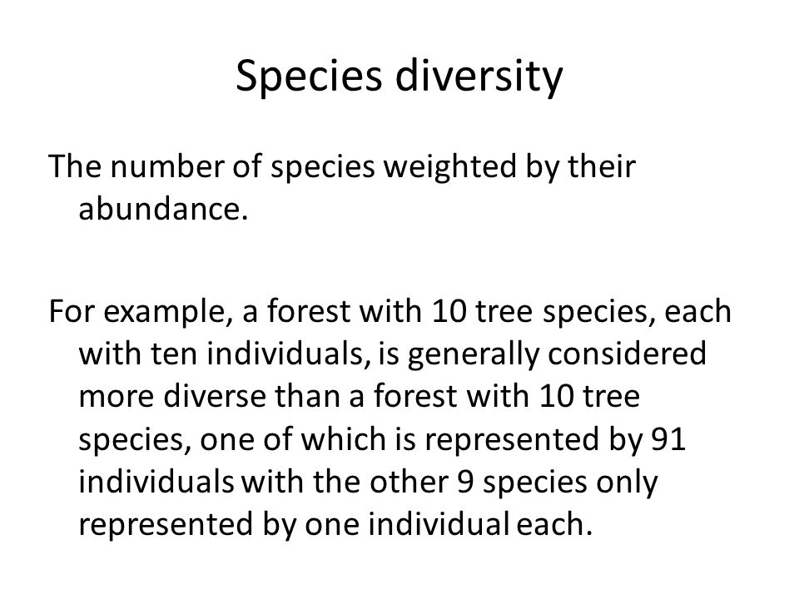
Diversity example

Slide 34
Selection Pressure
Selection pressure: factors that contribute to selection which variations will provide the individual (sequence) with an increase chance of surviving over others;
Can be positive or negative
An example of this is DNA mutation patterns resulting from a mutator that displays hot/cold-spots, substitution preference or other intrinsic biases
Calculation approach utilized in repcalc works by building a statistical framework for Bayesian estimation of antigen-driven selection based on the analysis of somatic mutation patterns
PMID: 22641856

Slide 35
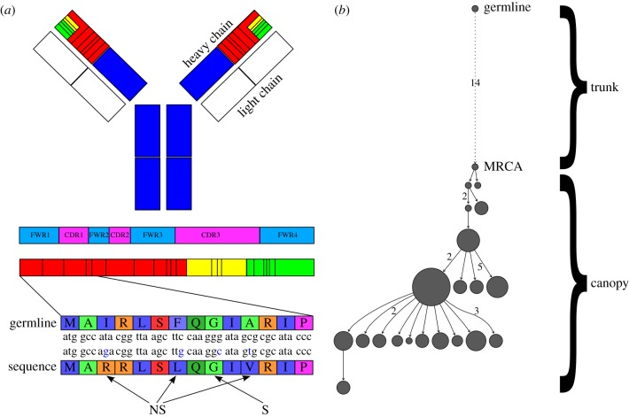
Selection pressure (example in B cells)
Antibodies are composed of two identical heavy chains and two identical light chains. The mRNA coding for each chain is divided into FWRs and CDRs, which are interlaced in the linear genetic code. To identify the somatic mutations that are accumulated during affinity maturation, antibody sequences are first aligned with the corresponding inferred germline sequence.

Slide 36
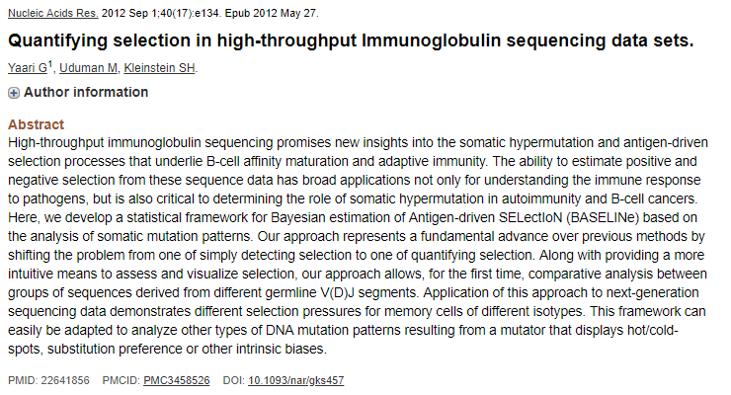

Slide 37
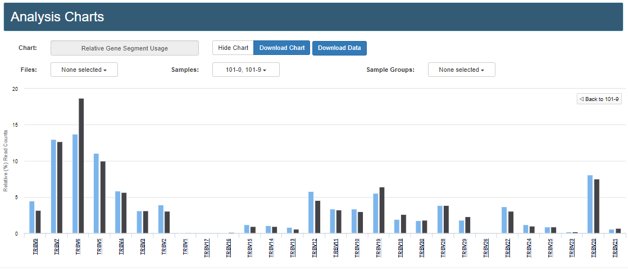
Example data showing gene segment usage
Blue- pre-treatment (0 wk)
Black- post treatment (9 wk)

Slide 38
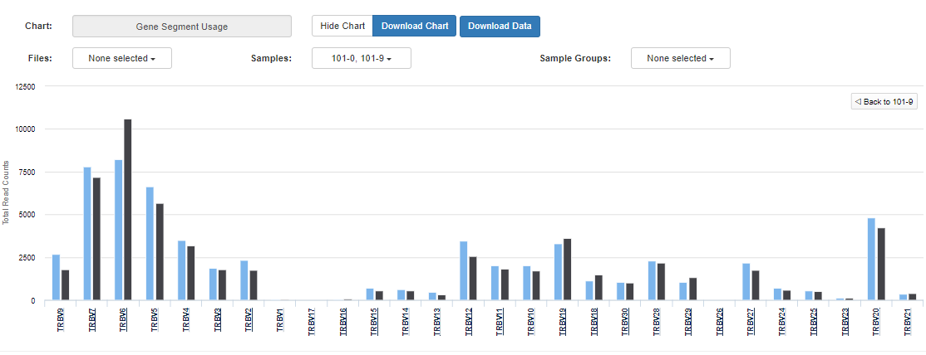
Blue- pre-treatment (0 wk)
Black- post treatment (9 wk)

Slide 39

Summary
VDJServer offers interactive visualizations for users
VDJServer executes all steps and generates analysis reports complete with data summary tables, statistical analyses, figures and workflow logs
VDJServer improves the efficiency of analysis by eliminating the need for significant manual manipulation of data
This improves data accuracy and reliability
VDJServer makes sophisticated computational calculations easily accessible

